Slide 1
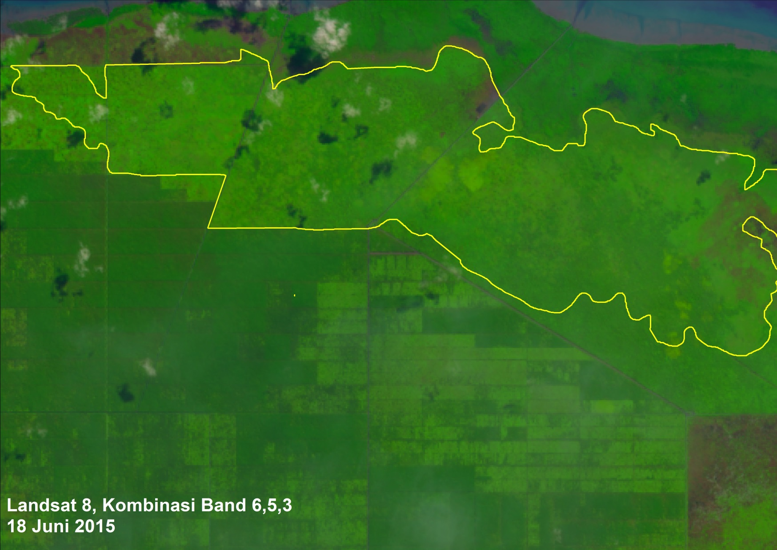
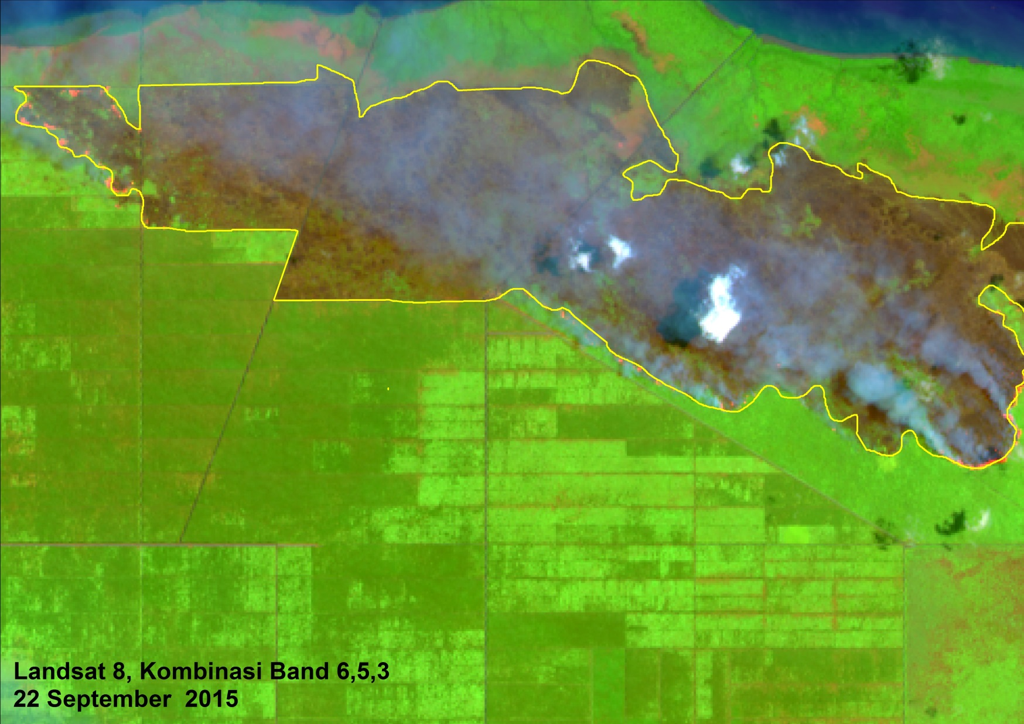
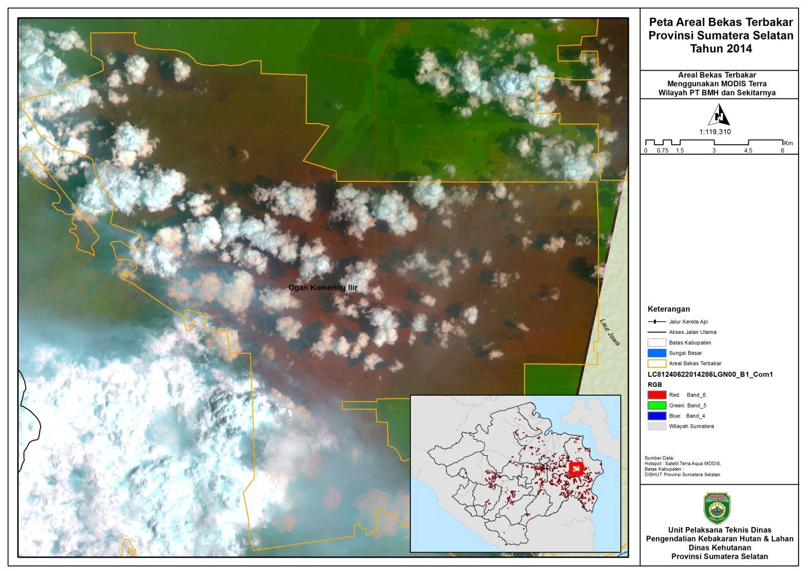
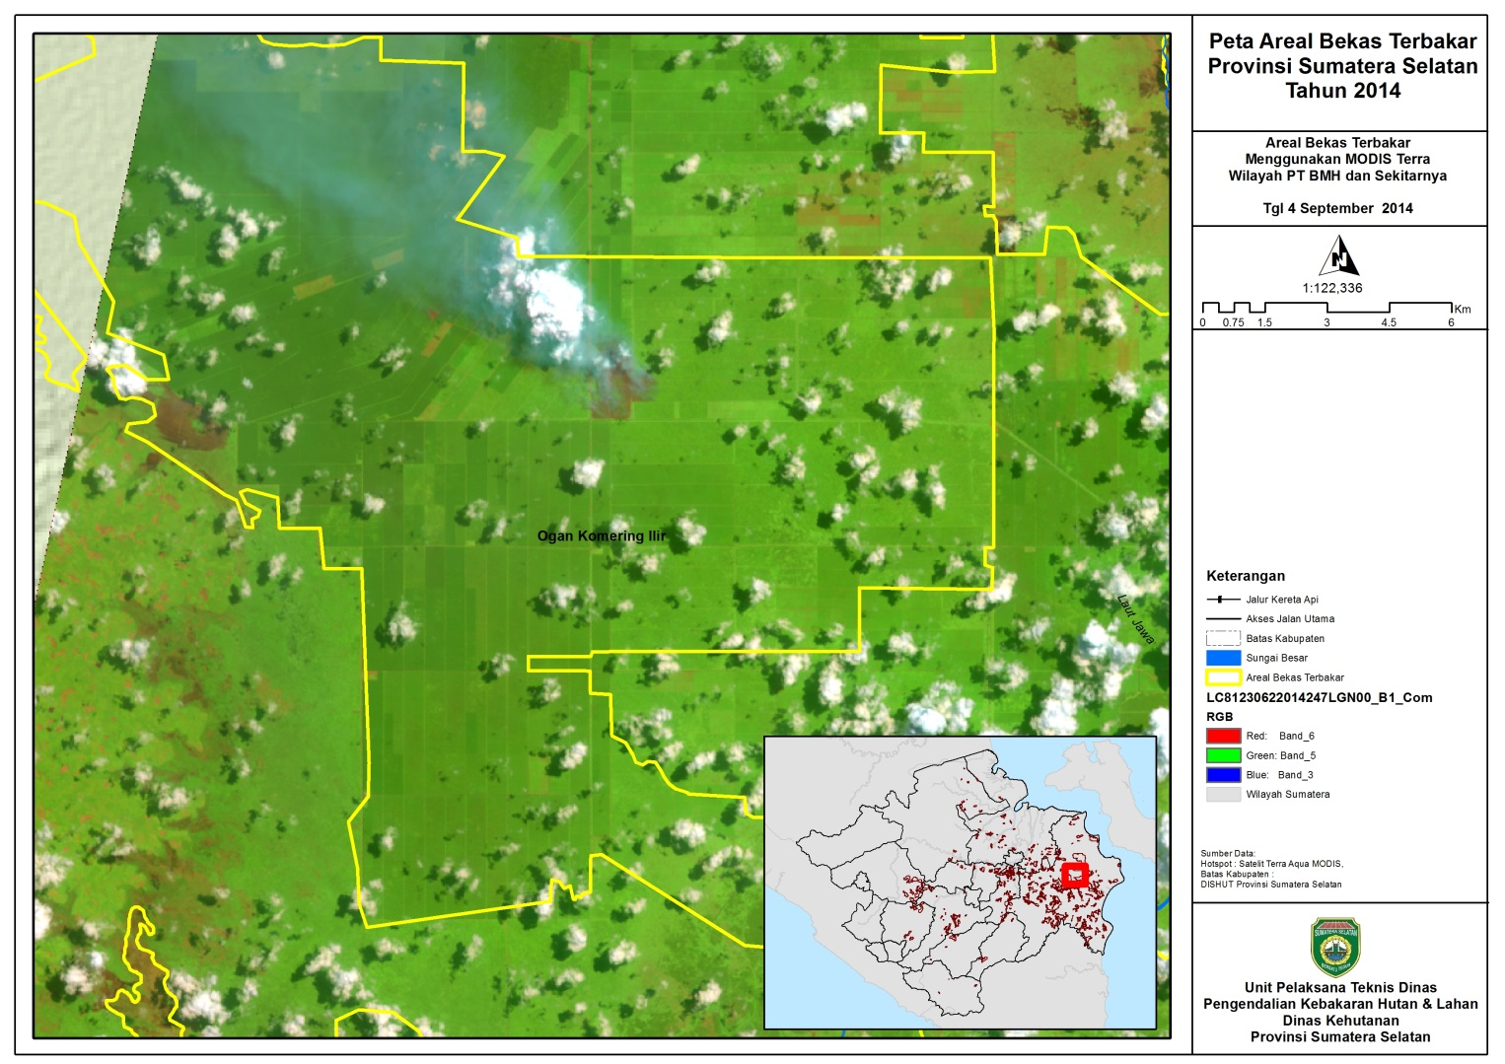
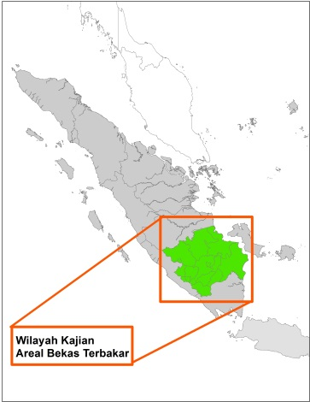
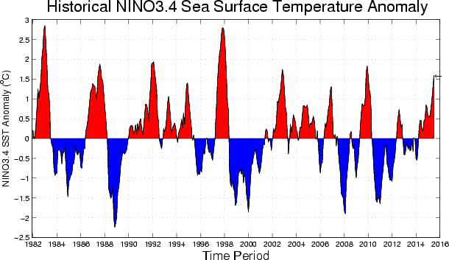
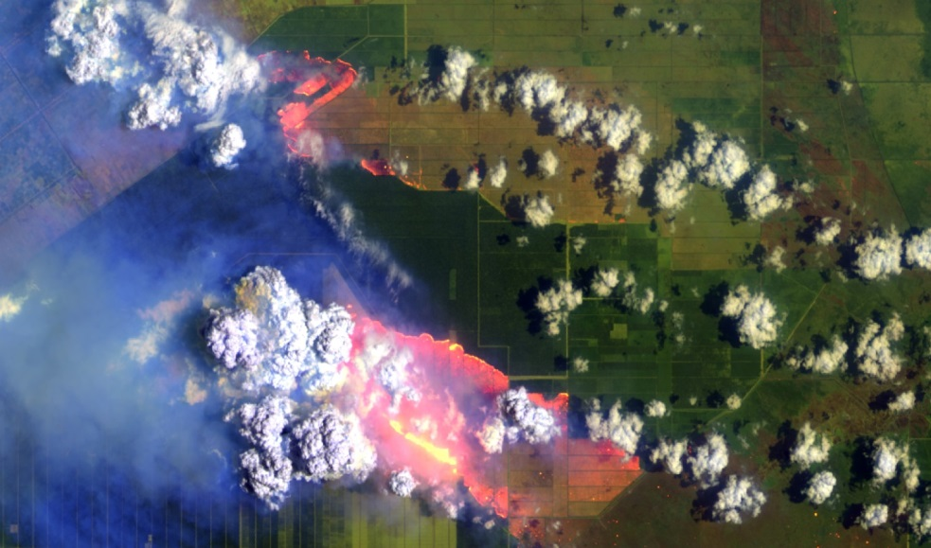
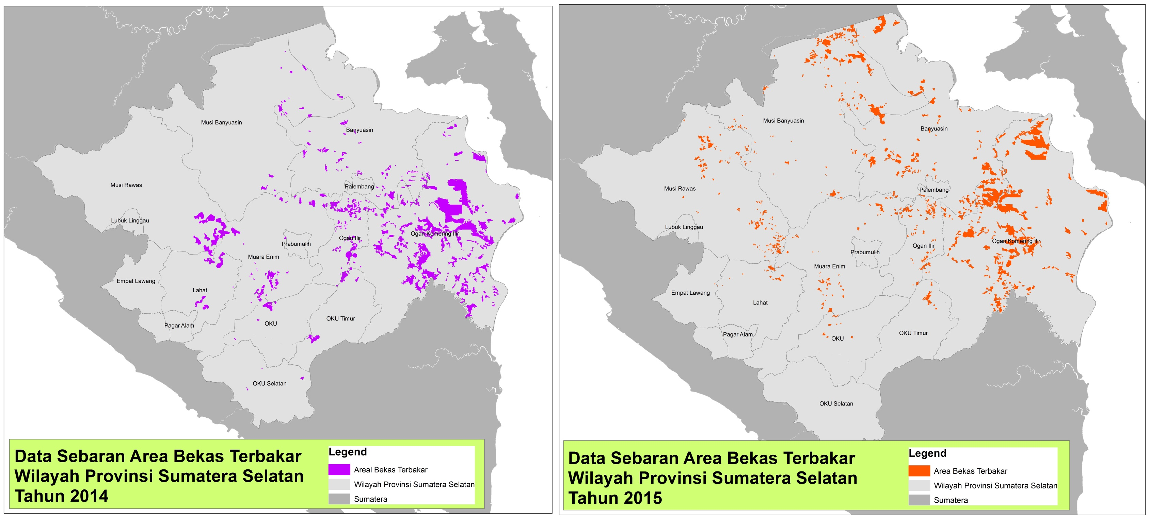
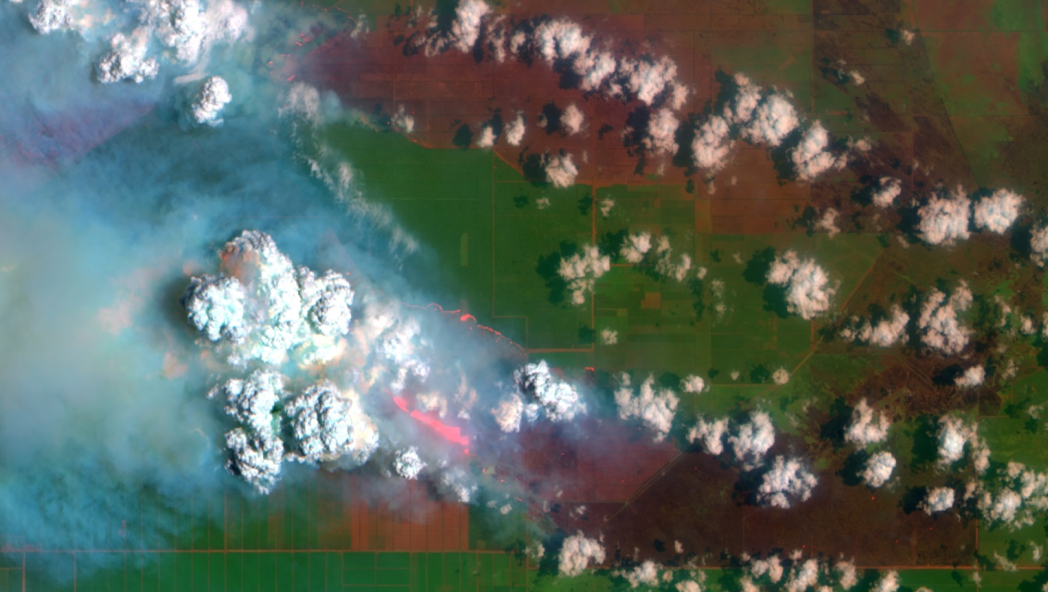
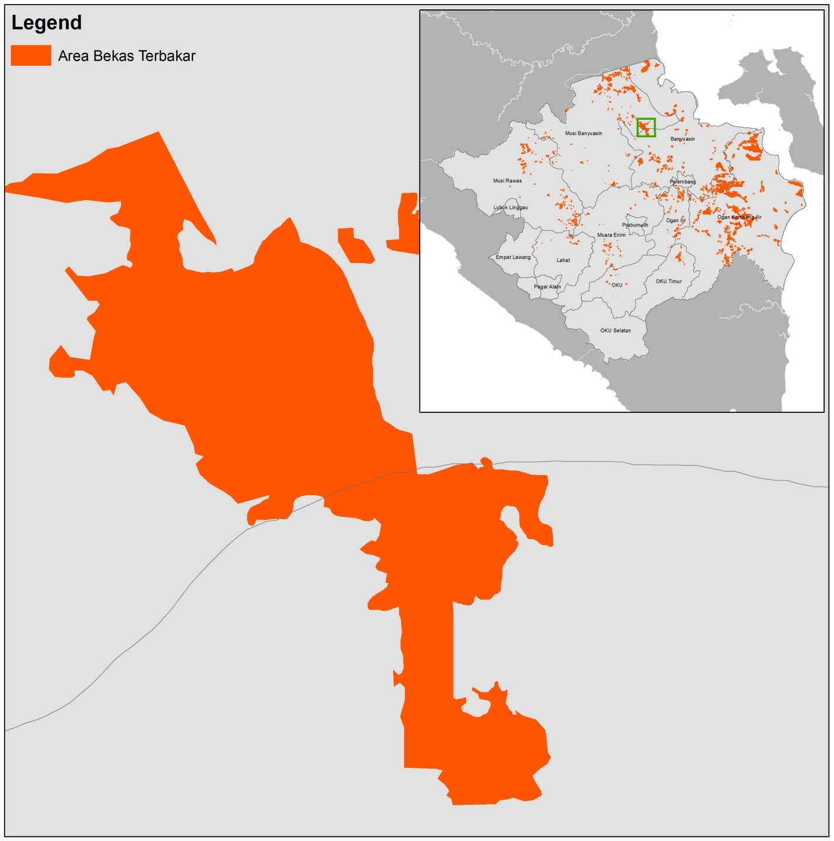
Measuring Burned Areas with Landsat Data to Monitor and Evaluate Burned Forest in South Sumatra 2014 - 2015
Muara Laut Tarigan, Berthold Haasler, Ahmad Taufik, Bonaventura Firman and Dudy Nugroho
Abstract
Forest and land fires are natural disasters that often occur during the dry season in Sumatra. These fires are a huge threat to forests and their biodiversity, as well as to Indonesia’s efforts in reducing global warming. These forest and land fire disasters have an impact on various sectors and are exacerbated by the El Niño effect. This poster will discuss post-disaster documentation processes to map burned areas for use in disaster mitigation planning. Remote sensing applications use free Landsat data and methods developed by LAPAN through manual interpretation. Landsat mosaics to determine burned areas are dominated by SWIR-1, Near Infra-Red (NIR) and Red composite bands. Delineation of burned areas was carried out by validating hotspot data with confidence values above 60% and field checks to test data accuracy. Data from 2014 shows a total burned area of 265,688 ha with 86% in peat ecosystems. While DTA analyses up to September 2015 show 69,515 ha with 90% in peat ecosystems. Locations burned in both 2014 and 2015 amounted to 7,708 ha. This information is important as input for disaster mitigation management by the Government.
Background
South Sumatra is one of a number of provinces with a history of fires coinciding with El Niño weather anomalies that have occurred over the last few years. Fires have broken out in El Niño years in the South Sumatra region in 1997, 2002, 2006 2009, 2012, 2014 and 2015.
Hotspots and Trends by Season for 1997 - 2015
Objective
The need for rapid and accurate data is frequently constrained by limited availability of data and infrastructure and by time constraints. The Mapping of burned areas is aimed at generating accurate information on burned areas for use by stakeholders, particularly regional Governments, in need of such information, so it may support Forest Fire Prevention Planning and Monitoring in their regions.
Methods
Creation of information on burned areas used on screen digitation with free-to-use Landsat 8 OLI TIRS base data available at www.earthexplorer.gov.
The Landsat 8 imagery, processed using remote sensing, when processed further produces channels from certain band compositions, which are then used to extract information on burned areas, so the final result is shapefile data on the area of burned areas.
Example of an identified burned area comparing conditions
before and after fires broke out
Results
Before
After
Landsat 8 OLI TIRS
September 2014
After
Landsat 8 Full Band, L1
Before
Landsat 8 OLI TIRS
October 2014
Band Compilation
30 meter resolution
Source : International Research Institute University Columbia
Areal yang sedang tebakar
Pan-Sharpened Process
15 meter resolution
Burning area
Study Area
Band Combination
Band 764
False Color
Band 653
Vegetation Analysis
Rainy Season
Dry Season
Image Data Delineation
Direct checking of condition of places identified as burned areas
Burned Area
Distribution of Burned Areas
In South Sumatra Province 2014
Burned Area
South Sumatra
Sumatra
Distribution of Burned Areas
In South Sumatra Province 2015
Burned Area
South Sumatra
Sumatra
Verification
Conclusion
Calculating burned areas using free data is quite effective for meeting needs for data relating to the area and locations of forest and land fires quickly, but the main constraint is the quality of available data. The preparation of imagery as base data could be improved in order to generate better quality base data.
Overlay with relevant hotspot distribution data
Jan Feb March April May June
July Aug Sept Oct Nov
Dec
Result:
Burned Area Data
SOUTH SUMATRA PROVINCIAL FORESTRY OFFICE
FOREST AND LAND FIRE MANAGEMENT TECHNICAL IMPLEMENTATION UNIT (UPTD PKHL)
Jl. Jenderal Sudirman KM 3,5 No. 2837 PO BOX 1229, Palembang, South Sumatra
Tel./Fax: +62 711 355 600
Contact: Muara Laut Tarigan
Office Address: Jl Jendral Sudirman No 2837 Tel. 0711 355600 / 081369059066,
email: adongtarigan@yahoo.com

