Slide 1
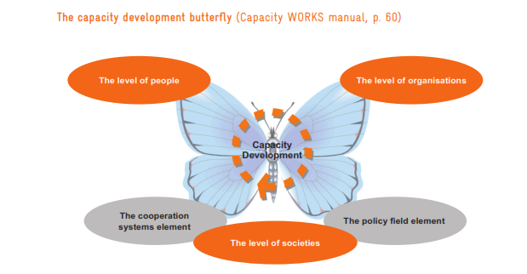
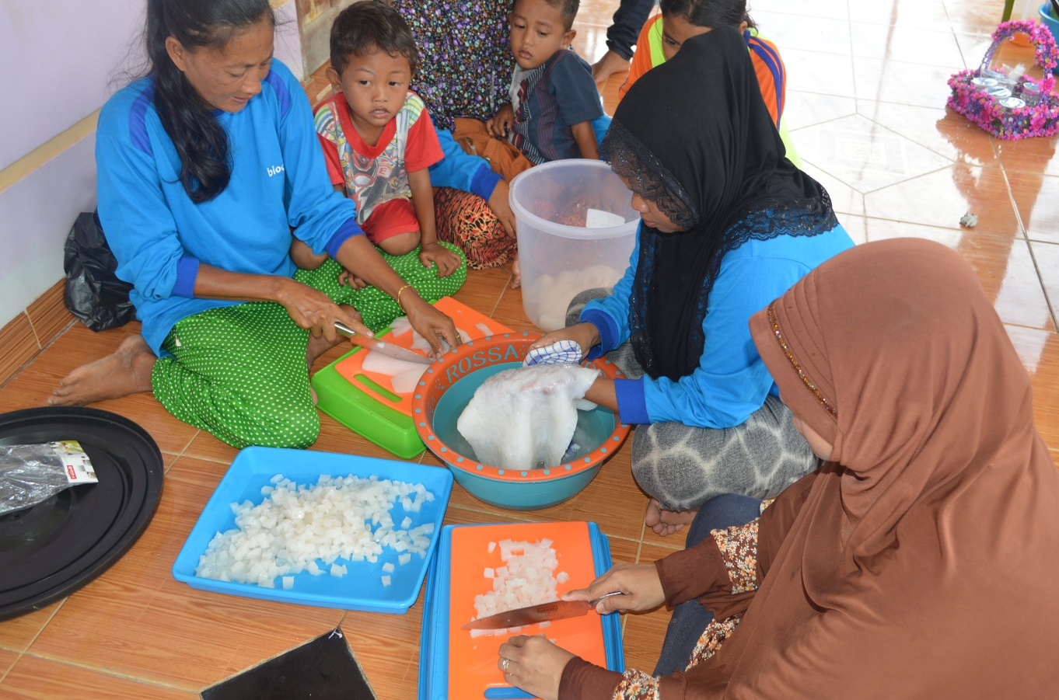
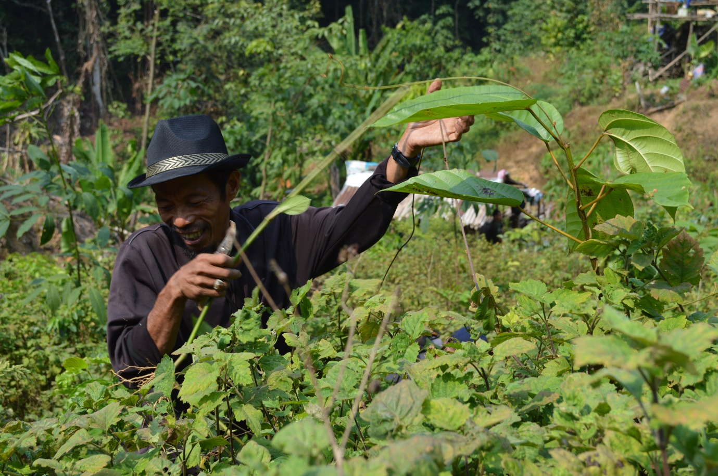
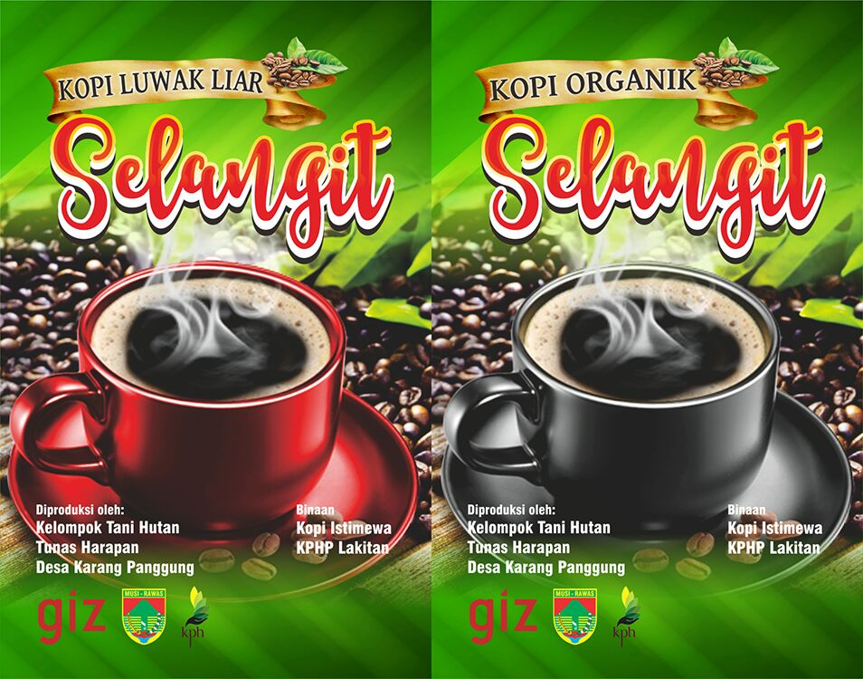
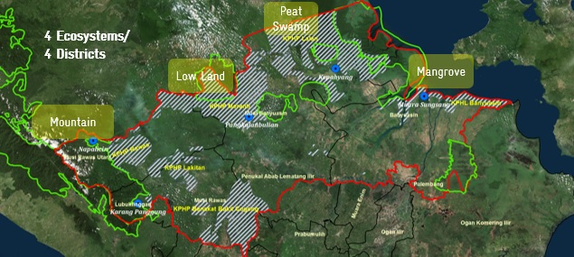
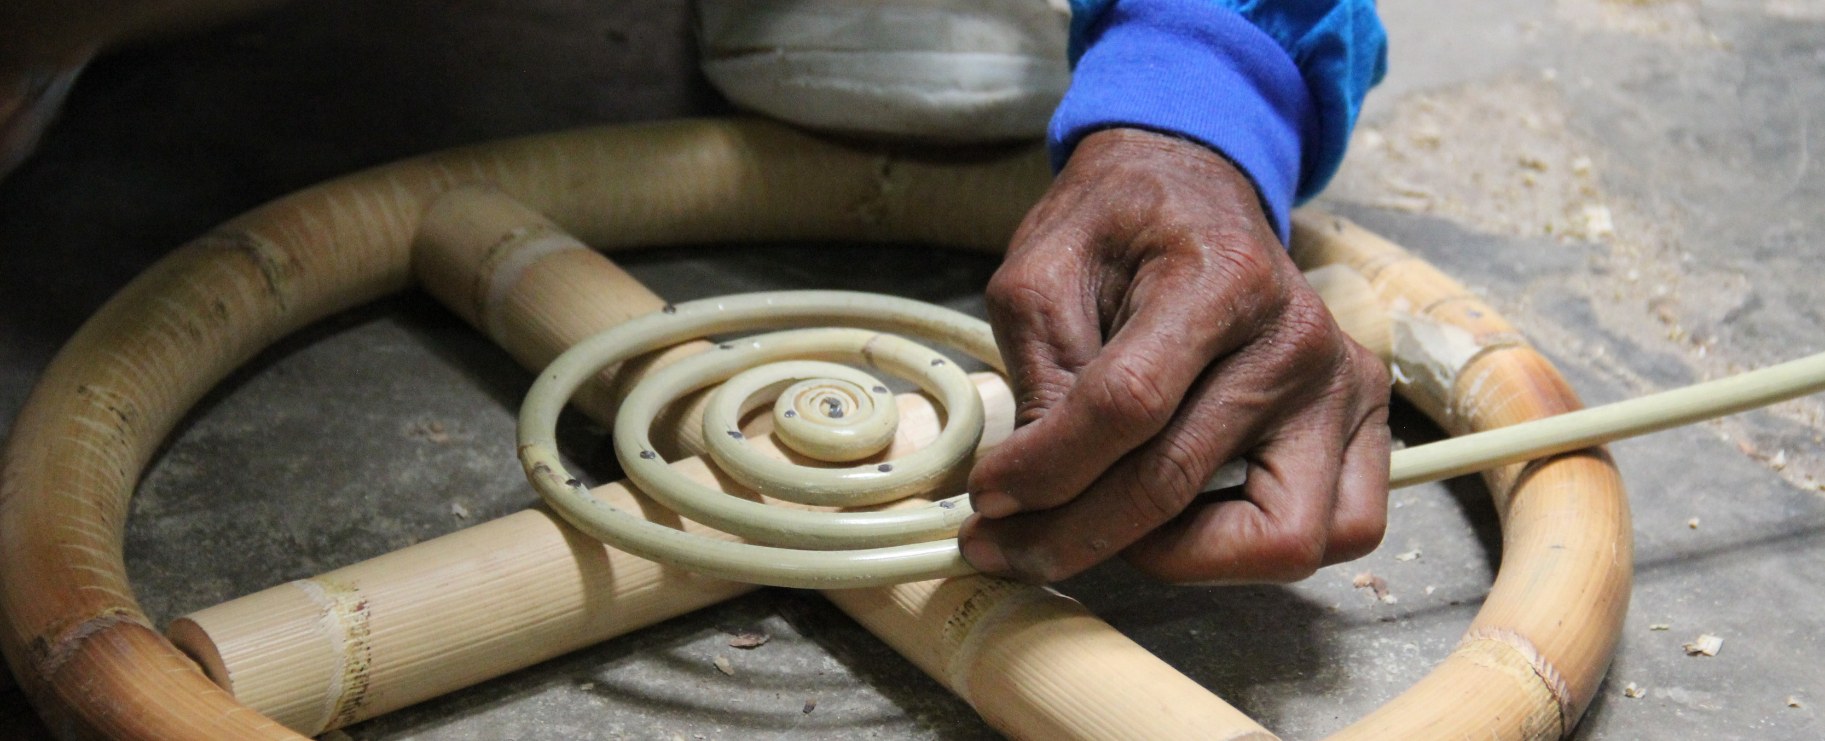
Building Resilient Forest Communities
Institutional Strengthening of Community Groups and
Non-Timber Forest Product/NTFP Business Development
Rattan
Coffee
Wild Honey
Rattan
Introduction
In this study, the term ‘resilient’ refers to forest communities who are aware of the threats of climate change and are able to manage and develop coping strategies. Based on scientific research, local communities have long been using forest ecosystems to sustain their livelihoods (Shackleton and Shackleton, 2014), and this depedency on natural resources can make local communities prone to unwanted changes and risks arising due to climate change and adverse forest conditions.
The importance of studying and assessing vulnerability was taken into account in order to provide baselines, and to identify threats and opportunities in developing alternative sources of income. Additionally, capacity development for local community groups also became a focus for reducing social vulnerabilities.
This study examines how institutional strengthening of community groups and development of Non-Timber Forest Product (NTFP) businesses are important for supporting communities’ resilience in their relationships with forests. Institutional strengthening helps community groups to enhance their capacity in organizational prosedures and practices, while NTFP business development indentifies potential resources for development and income generation.
Study Sites
The studies, carried out in the GIZ Bioclime working area, covered 5 villages in 4 priority districts in South Sumatra. These districts - Musi Banyuasin, Banyuasin, Musi Rawas and Musi Rawas Utara - represent 4 different ecosystem types and associated forest community group dynamics.
Figure 1. Study sites in South Sumatra
Approaches
Institutional strengthening involves capacity development for community groups. Sustainable learning covers various levels of individuals, organisations, and society (Figure 2A).
It includes networking with government institutions (the Ministry of Agriculture), Forest Management Units (FMUs), NGO service centres, and other related stakeholders. The networks support access to updated information (forest ecosystems, livelihood issues, etc).
NTFP Business Development is based on recommendations from several studies relating to income generation. The following tools were introduced for mapping NTFP priority: (a) CLAPS – Community Livelihood Appraisal and Product Scanning, (b) MA&D - Market Analysis and Development (Figure 2B). A further study on value chain and market analysis was conducted in order to understand chains of market players.
Resource identification : Forest, Non- Forest
----------------
Criteria-based selection
---------------
Market opportunity
---------------
NTFP priority
Benefits | Challenges
Broadening networks | Time constraints (processes, dynamics)
Opportunities for accessing funds/loans from governments and other donors | Need for multiparty engagement (villages, local governments, NGOs, etc)
Legal status (registered administratively) | Intensive monitoring (monthly)
Developed into business units | Many NTFPs are seasonal products
 | Extractive practices in harvesting NTFPs
(A)
(B)
Figure 2. (A) : The butterfly approach to capacity development (GIZ capacity works, 2014), (B) CLAPS and MA&D analysis
Results and Discussion
4
3
Description:
Socioeconomic Vulnerability Assesments
Establishment of Community Groups
Organizational Management (administrative, financial)
- Code of conduct (AD/ART)
- Bookkeeping, microfinance schemes
- Networking with: (a) FMUs, (b) NGO
service centres, (c) government
institutions, (d) companies, (e)
universities and research centres
2
5
(A)
(B)
(C)
6
1
Figure 4. (A) : Nata de Coco production in Muara Sungsang ,Banyuasin, (B): Nilam and Atsiri Oil Production (Patchouli Oil) in Napalicin, Musi Rawas Utara, (C): Organic Coffee Label. Coffee is produced by community groups in Karang Panggung, Musi Rawas
4. Mapping NTFP priority using CLAPS and MA&D
5. Training on NTFP production
6. Value Chain and Market Analysis (in-depth studies of players and markets)
Figure 3. The institutional strengthening and NTFP business development loop
strategy
Conclusions
Resilient forest communities are equipped with knowledge on how to manage community groups / organizations and how to develop NTFPs as alternative income sources.
Institutional strengthening prepares groups to participate in broader market and networking schemes.
Networking supports community groups in accessing updated information on
forests as well as NTFP-related information
NTFP business development discusses potential products for contributing effectively to community income.
Village, District, Ecosystem type | Community Group and Membership | NTFP business commodity
Napalicin Musi Rawas Utara (Montane Forest) | Citra Lestari (21 men, 5 women) | Bamboo, water Nilam/Atsiri Oil (patcholi), rubber
Karang Panggung Musi Rawas (Montane Forest) | Tunas Harapan (25 men, 4 women) | Ferns (pakis), blackbead (jengkol) Organic and Luwak Coffee, durian
Pangkalan Bulian MUBA (Lowland Forest) | Bulian Alam Mulia (31 men, 6 women) | Rattan, Wild honey (madu sialang) Durian, rubber
Kepayang MUBA (Peatswamp Forest) | Kepayang Lestari (19 men, 8 women) | Resin (Kemenyan) and pineapple (2015) Red ginger and Ubi Racun (Manihot glaziovii) (2016)
Muara Sungsang Banyuasin (Mangrove Forest) | Muara Sungsang Mandiri (20 men, 6 women) | Milkfish (bandeng), shrimp Nata de Coco (coconut gel), corn
BIODIVERSITY AND CLIMATE CHANGE PROJECT (BIOCLIME)
Jl. Jenderal Sudirman KM 3,5 No. 2837 PO BOX 1229, Palembang, South Sumatra
Website: www.bioclime.org
Tel./Fax.+62 711 353 176
Contacts:
Nyimas Wardah
Mobile: +62 811 711 3453
Email: nyimas.wardah@giz.de
Berthold Haasler
Mobile: +62 811 847 6728
Email: berthold.haasler@giz.de
Mohammad Sidiq
Mobile: +62 811 7129654
Email: mohammad.sidiq@giz.de

