Slide 1
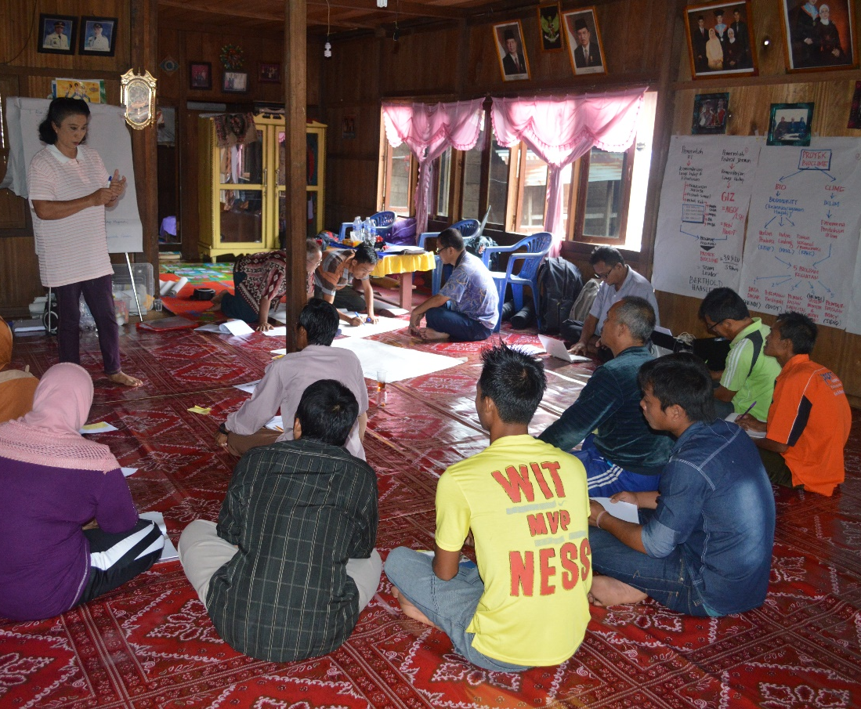
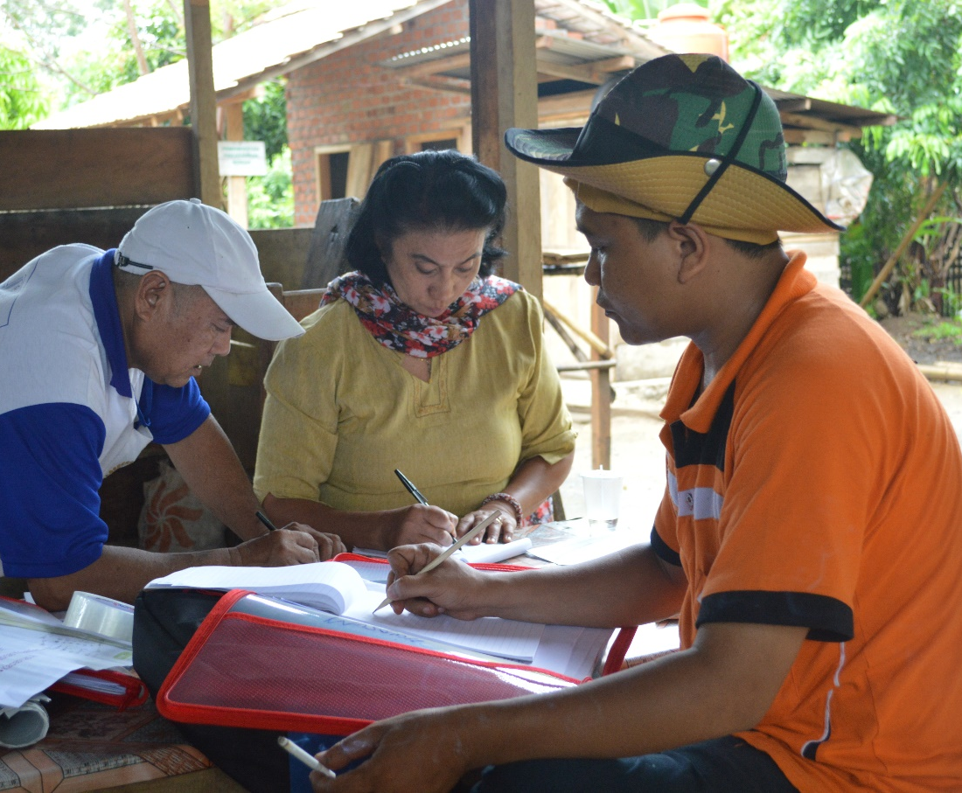
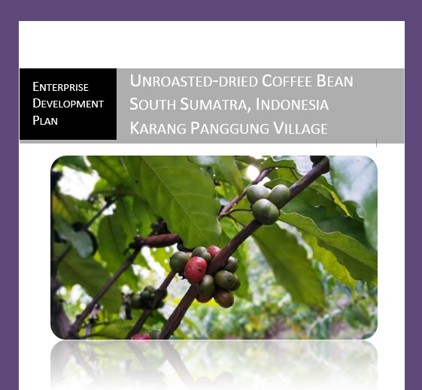
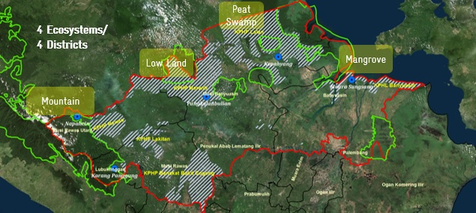
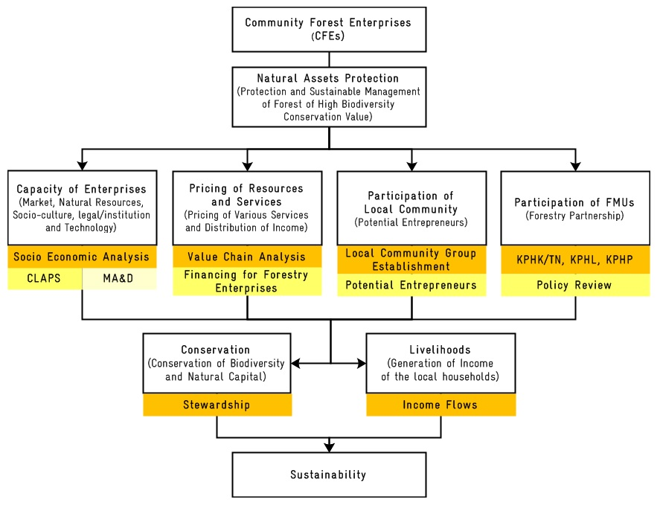
Community Forest Enterprises
in Forest Management Units
Introduction
In South Sumatra, forest degradation and loss of biodiversity have become major concerns in the management of high biodiversity conservation value forests. Loss off biodiversity affects the ecosystems’ capacity to adapt to changing climate conditions. It jeopardizes the livelihoods of rural populations who utilize materials (medicinal plants, resin, oils, fats, and rubber) and food from forest inside and outside protected areas. Yet the challenge of combining livelihood improvement and protection of high biodiversity conservation value forest seems largely unachievable.
In theory, many potential interventions can enable sustainable use of forests for community livelihood improvement. Through this study we seek to develop possible future management models that provide "win-win" outcomes, where livelihood improvement is matched with the advantages of sustainable management of high biodiversity conservation value forest. In this pilot project arrangement, we concentrate on ideas for developing Community Forest Enterprises (CFEs) to support such interventions. Capacity building for CFEs at the Forest Management Unit (FMU) level is important as knowledge regarding actions in this context is lacking in the forestry sector.
Using Community Livelihood Appraisal and Product Scanning (CLAPS) and Market Analysis and Development (MA&D) tools, this study seeks to develop CFEs by identifying the most promising Non-Timber Forest Products (NTFPs); identifying potential entrepreneurs from local communities; developing business ideas; and finding alternative strategies and business plans.
Methods
Figure 1. Framework of CFEs and Sustainability, modified from Sarkar and Sinha (2015)
Results and Discussion
Study sites are located in the northern part of South Sumatra province, adjacent to Jambi province to the north. The study has identified target areas in 4 forest ecosystem types in 4 districts: Banyuasin, Musi Banyuasin, Musi Rawas, and North Musi Rawas.
Figure 2. Study sites in South Sumatra
Figure 2: Study location and priority NTFPs
The study indicates that local FMUs have key roles to play in assisting local community groups with production and marketing chains, as well as integrating community needs and rights into forest ecosystem management concepts.
(A) (B) (C)
Figure 3. (A): Community group establishment and selection of potential community entrepreneurs; (B): Identifying ideas for community enterprises; (C): Enterprise Development Plan for unroasted, dried coffee beans, and identifying potential funding sources for community forestry enterprises.
Figure 4. CFE success factors in Forest Management Units
Creating Opportunities:
Potential for niche market
Higher market demand
Creating market incentives for forest ecosystem and biodiversity protection
Market
Partnership Management
Enabling Conditions:
Policy and legal review
Principal forest uses (forest area certainty and tenurial aspect)
The assets (natural, physical, human, financial, and social capital)
Safeguarding biodiversity and local livelihoods
Requirements:
Collaboration with
businesses to generate profits
Forming partnerships with commercial companies/FMUs to provide practice-based leraning
Sharing of power and responsibility between local governments/FMUs and community entrepreneurs
Policy and Legal/Institution, Principal Forest Uses, Safeguarding and
Market Value
Conclusions
Enabling conditions, this study identifies policy-driven (principal forest uses, access to financing mechanisms, partnerships with FMUs) and market-driven opportunities. In some cases communities provide some basis for assuming CFEs may become community entrepreneurs in the future.
Collaboration with businesses where community entrepreneurs are used to generate profits for the community through partnerships or leasing arrangements with local businesses and investors rather than the community trading or managing the assets themselves.
The selection of various types of NTFPs is strongly related to the livelihoods of local communities in each village. NTFP collection is still important for household uses (subsistence) and cash income. Although NTFPs provide more subsistence than cash income, money earned from NTFP sales still enables villagers to obtain things from nearby markets. Furthermore, some NTFPs have large and reliable markets supplied by specialized producers.
References
Sarkar, R. and Sinha, A. 2015. The Village as a Social Entrepreneur: Balancing Conservation and Livelihoods. Journal of Tourism Management Perspectives 16 (100-106).
Sunderlin, W.D., Arild., A., Belcher, B., Bulgers, P., Nasi, R., Santoso, L. and Wunder, S. 2005. Livelihoods, Forests, and Conservation in Developing Countries: An Overview. World Development 33 (1383–1402)
BIODIVERSITY AND CLIMATE CHANGE PROJECT (BIOCLIME)
Jl. Jenderal Sudirman KM 3,5 No. 2837 PO BOX 1229, Palembang, Sumatera Selatan
Website: http://www.bioclime.org; Email: bioclime@giz.de
Telpon/Facsimile: +62 711 353 176
Contacts:
Mohammad Sidiq
Jl. Jenderal Sudirman KM 3,5 No. 2837 PO BOX 1229, Palembang, Sumatera Selatan
Mobile: +62 811 712 9654. Email: mohammad.sidiq@giz.de
Berthold Haasler
Mobile: +62 811 847 6728.
Email: berthold.haasler@giz.de
Zulfikhar
Mobile: +62 812 710 2634.
Email: zulfikhar.zl@gmail.com

