Slide 1
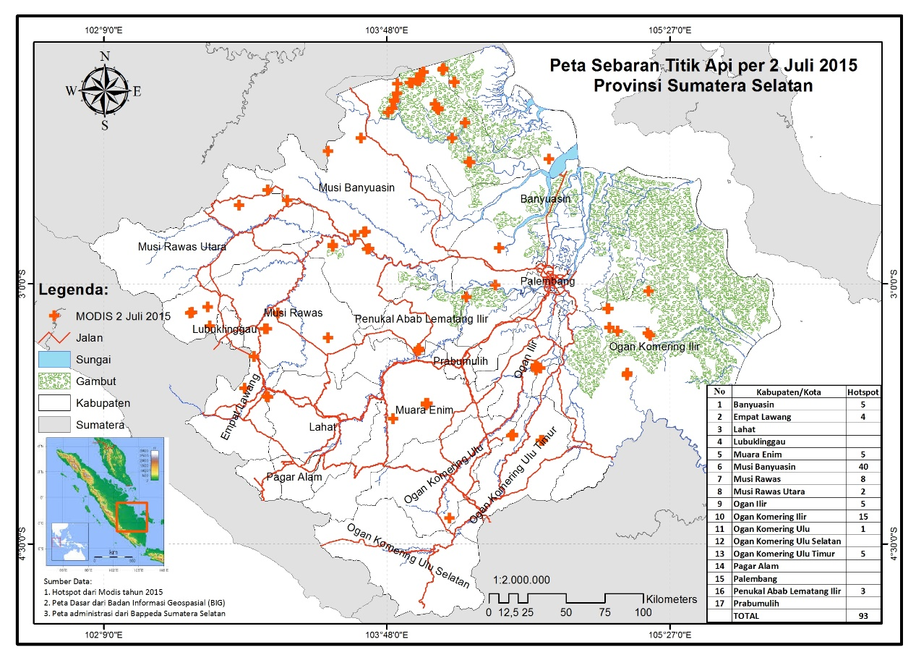
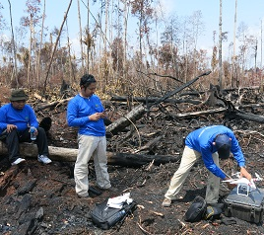
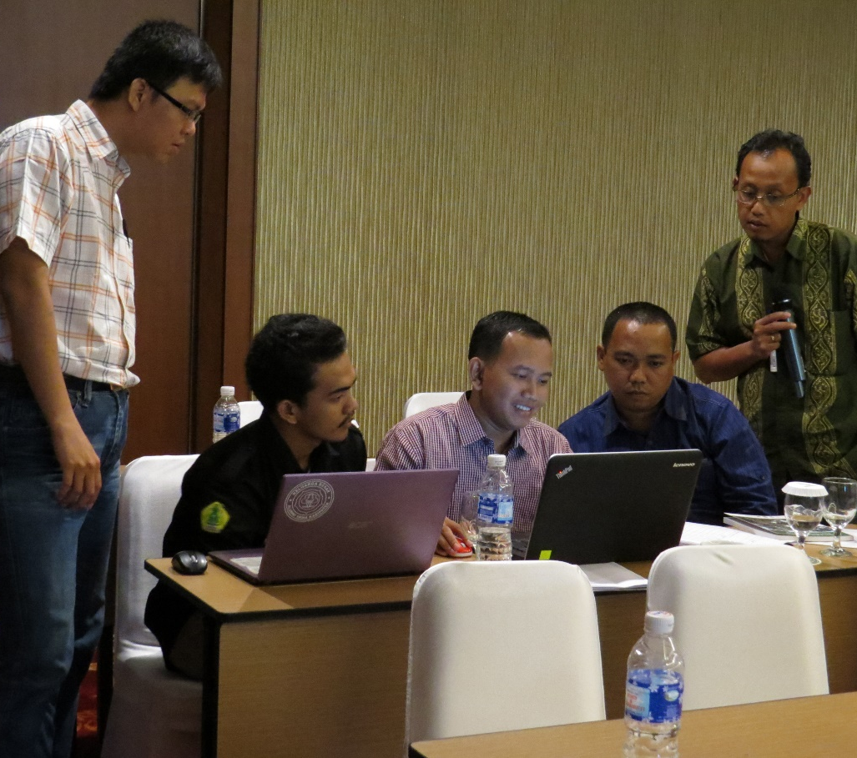
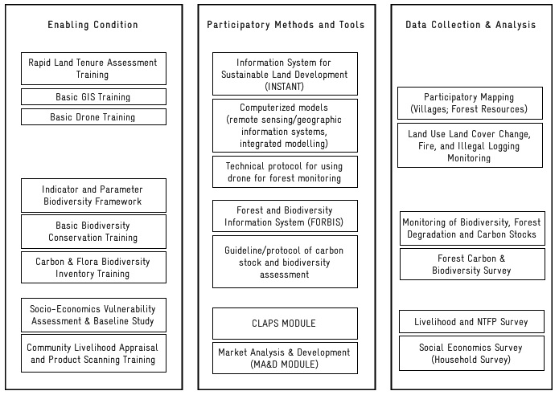
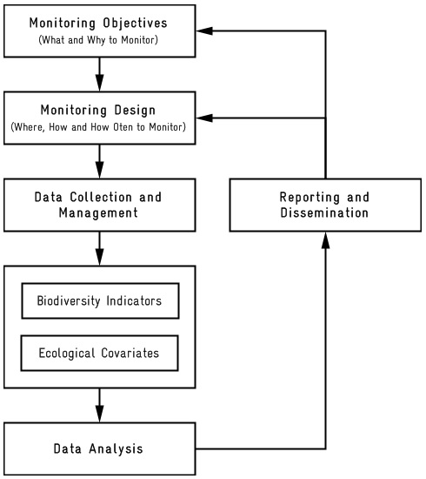
Participatory Ecological Monitoring
in High Conservation Value Forest Ecosystems in South Sumatra
Introduction
In order to ensure the sustainability of the structures and functions of forest ecosystems, a reliable monitoring system is indispensable. The current systems for monitoring and evaluating forest ecosystem status and trends in South Sumatra are inadequate and inconsistent.
Participatory Ecological Monitoring [PEM] is an initiative that adopts a participatory approach to analyzing potential sources of interference to forest ecosystems and the probability of disturbances to biodiversity, as well as social and economic vulnerability. PEM refers to the systematic steps corresponding to the local context. In particular, PEM uses a participatory decision-making approach to analyze the social and economic aspects and comparative vulnerability of each forest ecosystem type in terms of interference and possible "causes and pressure" to forest biodiversity.
Lessons Learned from BIOCLIME describe this scenario in high conservation value forest ecosystems in South Sumatra.
Methods
Results and Discussion
Figure 1. Participatory Ecological Monitoring Scenario
The key lessons to be drawn from this initiative are the need for raised awareness among all stakeholders and high levels of participation in the design of PEM.
In its methodology, PEM involved at least 6 factors: (1) improving participants’ understanding of the system; (2) forestry offices in South Sumatra initiating the process; (3) a team comprising key stakeholders; (4) participation retention of about 50–80% for those participants attending the whole process; (5) a selection process involving participants in concept design, method selection, analysis of results, and communication of results; (6) participatory methods and tools being categorized either as computerized models (remote sensing/geographic information systems, and modelling) or non–computerized models.
(A) (B) (C)
Figure 2. A) Forest and Land fire hotspots; B) Ground truthing for fire monitoring; and C) Data analysis by stakeholders
*DSS: Decision Support System
Figure 3. Representation of the Participatory Ecological Monitoring Scenario
Opportunites:
Filling gaps
Influencing decision
Long-term impact
DSS
Collaboration
Requirements:
Collective action protocols
Data sharing protocols (Data Network)
Database management protocols
Accountability
Capacity building
Enabling conditions:
Policies
Capacity building
Guidelines/data collection and analysis protocols
Conclusions
The main output is the development of a decision support system for the sustainable management of high conservation value forest ecosystems.
Intended impacts are improved understanding among stakeholders of the main elements of the system: how to carry out forest ecosystem planning; how to tailor activities to the landscape; capacity building; increased collaboration, trust and networking; and relationship building (learning about each other's constraints).
Impacts are identifiable both through individual actions and collective actions.
References
Hassenforder, E., Smajgl, A. and Wart, J. 2015. Towards understanding participatory processes: Framework, application and results. Journal of Environmental Management 157 (84-95)
BIODIVERSITY AND CLIMATE CHANGE PROJECT (BIOCLIME)
Jl. Jenderal Sudirman KM 3,5 No. 2837 PO BOX 1229, Palembang, Sumatera Selatan
Website: http://www.bioclime.org; Email: bioclime@giz.de
Telpon/Facsimile: +62 711 353 176
Contact:s
Berthold Haasler
Jl. Jenderal Sudirman KM 3,5 No. 2837 PO BOX 1229, Palembang, Sumatera Selatan
Mobile: +62 811 847 6728. Email: berthold.haasler@giz.de
Mohammad Sidiq
Mobile: +62 811 712 9654.
Email: mohammad.sidiq@giz.de
Hendi Sumantri
Mobile: +62 811 719 1976.
Email: hendi.sumantri@giz.de

